Slide 1

Department of Biochemistry
Metagenomic Assembly:
Applications and Advancements
DNA Genotek/Diversigen
Ben Joris
November 17th, 2020
Notes:
Hello everyone, my name is Ben Joris and today I will be giving a talk on metagenomic assembly; the construction of microbial genomes from a mixed population. I will discuss some of the use cases I have applied in my research and some of significant advancements that have occurred in the last year or so that have completely revolutionized metagenomic assembly and analysis. Long-read sequencing represents a market opportunity for both bioinformatic services and particularly for reagent development.

Slide 2

About Me
3rd year PhD Candidate in the Gloor Lab
BMSc and MSc at Western
My research is strictly computational and focused on the human gut microbiome
Notes:
Now to tell you a little bit of my background. I am a 3rd year PhD candidate under the supervision of Greg Gloor at Western University. Our lab focus is on developing new metagenomic analyses, investigating environmental microbial communities, and exploring connections between the human gut microbiome and health. I have also completed a Bachelor of Medical Sciences and a non-thesis Master of Science in biochemistry at western. My own research is strictly computational and I mostly focus on the human gut, but I will be exploring some of the data that my labmate Dan has collected to search for conjugative systems.

Slide 3
Agenda
Introduction to metagenomic assembly
Applications of metagenomic assembly
Identifying insertions in CRISPR-carrying plasmids
Separating kidney stone former gut microbiome from healthy controls
Population and age differences in conjugative systems found in human gut
Recent advancements in metagenomic assembly
Notes:
To begin this presentation, I will introduce metagenomic assembly. I will do my best to help everyone understand the challenges of this abstract and computational process. Afterwards, I will talk about three separate research projects and how metagenomic assembly revealed some very interesting results. Finally, I will talk about our work with long-read sequencing technology.

Slide 4

Introduction to Metagenomic Assembly

Slide 5
Goal of metagenomic assembly
Reconstruct bacterial genomes from a mixed population of bacteria (e.g. human gut)
Difficulty scales with complexity of community
Mixed bacterial community
Closed bacterial genomes
Notes:
The ultimate goal of metagenomic assembly is to assemble the genomes of all the bacterial present in an environment. As you can imagine, this is more difficult than it sounds, and the difficulty scales with the complexity of the community. The goal of assembling closed genomes is never achieved with short-read sequencing on Illumina platforms, even with the simplest of communities.

Slide 6
Metagenomic assembly overview
Extraction and library prep
Sequencing with Illumina
💩
reads.fastq.gz
Assembly with metaSPAdes
- P. copri
- B. ovatus
Taxonomic assignment of bins
Binning with MetaBat2
- R. bromii
- C. difficile
scaffolds.fa
Notes:
Displayed on this slide is a simplistic view of the metagenomic assembly of a human faecal sample. First, the genetic content of the faecal sample must be extracted, purified, and prepared into libraries for sequencing on an Illumina instrument. Following sequencing, the data are output into the FastQ file format. Using an assembler, such as metaSPAdes, the sequencing reads are pieced together into larger fragments called contigs. Again, these contigs are never the full sequence of a bacterial genome, rather just fragments. To group these fragments together, we perform a step called binning, which examines features, such as multisample abundances and tetranuclueotide frequencies, and looks for similarities. These, bins are incomplete approximations of the bacterial genomes, and we can assign bacterial taxonomy to them using clade specific markers with programs like PhyloPhlAn.

Slide 7
Why metagenomic assemblies break
I went away for a long long long long time
I went away
Went away for
Away for a
For a long
A long long
Long long long
Long long long
Long long time
”Genome”
“Sequencing Reads”
Notes:
To explain why assembly algorithms break, imagine you have to assemble this sentence by overlapping 3 word long fragments from it. ”I went away for a long long long long time” as you can imagine, when you’re trying to figure out how many ”longs” there are, it becomes impossible. You just know that there are a number of longs, but can’t determine how many. This is a common issue in genomes, and the assembly algorithm will simply split the genome at this location.

Slide 8
Metagenomics vs. 16S gene sequencing
16S rRNA gene sequence has limited information
No information on:
Plasmids
Integrative and conjugative elements
Sequence variants
Equivalent 16S gene, one has plasmid with antibiotic resistance
Notes:
To compare metagenomic sequencing to 16S rRNA gene sequencing, there are some clear advantages. Obviously, 16S sequencing is much less expensive. However, for many situations, knowing the nuance of the community is much more valuable than the broad community composition information that 16S sequencing can provide. 16S sequencing only provides taxonomic information, and inferring functional information from the taxonomic information is a dangerous game. 16S sequencing provides no information on transferrable genetic material such as plasmids of integrative and conjugative elements or functionally relevant sequence variants within species and strains. As an example, two bacteria may have the exact same sequence for their 16S rRNA gene, and even their entire chromosome, but one may have received a plasmids carrying antibiotic resistance through conjugation with another bacteria. For assessing the health of a person, such details could make a large difference.

Slide 9
Assembly vs. read-based analyses
Brief background, there are assembly-free tools to analyze metagenomic sequencing data
Taxonomy:
MetaPhlAn2
Kaiju
Function:
SEED database
Uniref50/90
Database
Notes:
Many programs are available that can analyze metagenomic data assembly-free. To put it simply, these programs are large databases that the individual reads are aligned to using a program like BLAST. The number of reads mapping to each entry in the database creates a table of counts that can be analyzed. There are taxonomic databases with clade-specific markers to be aligned to such as MetaPhlAn2 or Kaiju and functional databases like the SEED database or the Uniref databases.

Slide 10
Assembly vs. read-based analyses
Like with 16S gene sequencing, individual reads are information-poor
Difficult to assign read to entry in large database
Databases are may not include components of your community
Notes:
However, these methods have their own issues to contend with, because like 16S gene sequencing, an individual short-read does not have a lot of information. All bacteria bear large amounts of similarities across the genome, so aligning reads to an individual entry is quite difficult and made even more difficult by sequencing errors. Additionally, if you are sequencing communities that are not well characterized, such as environmental samples, the databases are not adequate to characterize the taxonomy or functionality of the community.

Slide 11
Benefits of assembly
Construct genomes that are present in community
Enable mapping of metatranscriptome to genomes
Strain-level resolution of differences
Strain tracking in faecal microbiota transplants
Notes:
To summarize the benefits:
Metagenomic assembly allows you to construct the genomes of bacteria that are present in a community.
To these assembled genomes, you can map the metatranstriptomic data.
You have the ability to resolve strain differences between samples. Strain differences have been suggested to be difference between cohorts in certain conditions such as resistant atherosclerosis.
When monitoring a FMT trial, you can monitor the integration of strain into an individual’s microbiome.

Slide 12
Limitations of assembly
With short reads generated by Illumina sequencing, genomes will ALWAYS be fragmented
Chimeric assemblies are common
Expensive for sequencing and for computational resources
Notes:
The limitations of assembly as I have described it so far are that the genomes will always be fragmented at repeated regions; chimeric genomes are common, binning algorithms will inevitably include a contig that does not belong; and it is expensive to sequence deeply enough for quality assemblies and to have the computational power to run the assembly programs.

Slide 13
Applications of metagenomic assembly
Identifying insertions in CRISPR-carrying plasmids
Notes:
Moving on to the applications of assembly. I will first discuss a simple use case where I identified insertions in a CRISPR carrying plasmid.

Slide 14
Background of project
Use CRISPR system carried on conjugative plasmid to selectively kill pathogenic bacteria
Effective in vitro at killing Salmonella enterica
Results could not be replicated in mouse model
Notes:
This project was in collaboration with another lab on campus. Their goal was to use CRISPR carried on a conjugative plasmids to selectively kill pathogenic bacteria; effectively replacing antibiotics for gastrointestinal infections. They found that it was remarkable efficient in vitro at killing Salmonella, but they could not replicate the results in a mouse model.

Slide 15
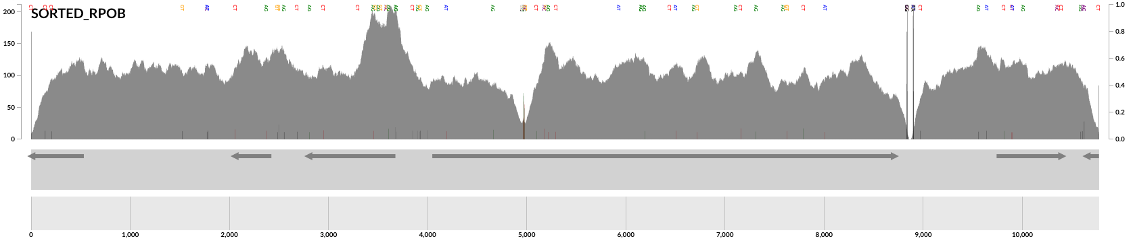
Assembly showed deleterious insertion
Mapping short reads to reference showed sequence anomaly
Assembly confirmed presence of insertion
Notes:
They turned to me to analyze the sequencing data to determine what was happening to their plasmids when administered to the mice. Upon sequencing and mapping to the reference genome, there was clearly an issue in the open reading frame of the Cas9 protein, illustrated by the dip in coverage highlighted by the red circle. When I assembled the plasmid sequence, I confirmed that the was an insertion of a sequence at the location, which likely inactivate the bactericidal system.

Slide 16
Applications of metagenomic assembly
Separating kidney stone former gut microbiome from healthy controls
Notes:
The next application of assembly will be a collaborative project that I am in the midst of working on.

Slide 17
Background of project
Kidney stone formers separated from healthy controls with metabolomic and 16S gene sequencing analyses
Use metagenomics to gain better understanding of the nuance to the differences
Notes:
I am not as well-versed on the background of this project as I have joined the project as it has neared completion. The general goal of the project is to examine the role of the human gut microbiome in the formation of Kidney stones. Previous to me joining the project, differences were observed for both metabolomic data and 16S sequencing data. To gain a better understanding of the strains and functional pathways responsible for these differences, we have employed metagenomic assembly.

Slide 18
Read-based analysis shows difference
MetaPhlAn2 analysis:
Notes:
As I previously mentioned, there are read-based analyses that can be used to analyze metagenomic sequencing data without assembling into genomes. One of these is MetaPhlAn2, which taxonomically characterizes the reads. And appears to have successfully separated the cases from the controls on this principal component diagram, at least somewhat.

Slide 19
Read-based functional analysis fails to show differences
SEED database analysis:
Notes:
Another read-based analysis is aligning the reads to a protein database with the hopes of finding functional differences between the cohorts. However, these databases are far from complete, resulting in the majority of reads not successfully aligning. As we can see on this principal component plot, the data are essentially overlapping.

Slide 20
Assembly-based analysis shows difference between groups
Notes:
I have just recently completed the assembly and binning of the data. I then aligned the reads to the genome bins using bowtie2 to quantify the relative abundances of the data. In this principal component plot, we can see separation between the groups on diagonal plane composed of both principal component one and component 2. This is analogous to the separation of the metaphlan data because the are quantifying the abundances of species in a community. However, now I can further inspect these genomes for functional pathways that are discriminatory and strain differences.

Slide 21
Next steps in analysis
Phylogenetic analyses of the assemblies to assign taxonomy
Analyze nucleotide variation data for strain-level analyses
Integrate functional analyses with differentially expressed bacteria
Notes:
I have yet to assign taxonomy to the bins. I plan on using PhyloPhlAn to do so and build a phylogenetic tree of the bins. I will also attempt to analyze the nucleotide variation data. There is bound to be an extraordinarily large amount of variation over 1400 genomic bins. I also plan on conducting a functional analysis of the genomes with a particular focus on the differentially expressed bacteria.

Slide 22
Applications of metagenomic assembly
Population and age differences in conjugative systems found in human gut
Notes:
The final application of short-read metagenomic assembly from my research that I will discuss before moving onto long-read sequencing and assembly is my work on investigating conjugative systems in the human gut.

Slide 23
Objectives
Wanted to identify plasmids that could be stably expressed in the human gut
Assemble short-read data and use reference human metagenome set
Quantify relative abundances of conjugative system in eight cohorts
Notes:
This project was spawned from the idea that if we wanted to express CRISPR carrying plasmids in the human gut, we would need plasmids that originate from the human gut, not plasmids that are used in lab strains. My goal was search for conjugative systems in assembled short read data and a reference human metagenome set. I also wanted to see how plasmids were differentially abundant in eight cohorts.

Slide 24
Assembly of conjugative systems
Assembly with metaSPAdes
Identify conjugative contigs
reads.fastq.gz
scaffolds.fa
Notes:
First, I will explain the process for how I went about identifying these systems in the metagenomic assemblies of short read data. I downloaded read data from NCBI’s SRA and assembled them using the program metaSPAdes. Because the output of metaspades is massive, I had to be careful to use a method of identifying conjugative systems that would scale very easily. I chose to use profile Hidden Markov Models of conjugative proteins to only annotate those proteins across all the assembled contigs. I searched for contigs that had annotations for all the protein categories necessary for a plasmid to be able to transfer itself to another bacteria. I then quantified these contigs across the samples I used for assembly.

Slide 25
Comparison of PT infant to general population
Notes:
I had two different cohorts whose short read data was used for assembly. One cohort was a general north American population that was used for investigating irritable bowel syndrome and the other cohort was a sample of north American preterm infants. As you can see on this principal components plot, particularly in comparison to the previous ones that I showed, these two cohorts separate remarkably well. It’s expected that they would be different, because newborn infants already have very different microbiotas that adults, but they are preemees that are given constant antibiotics, so they’re even more different.

Slide 26
Comparison of PT infant to general population
Notes:
I was hesitant to include this diagram because it’s a lot to take in during a powerpoint but I love it so I wanted to include it anyways. On this diagram, think of it as rings of a tree and slices of a pie. The rings of the tree are individual samples, and the slices of the pie are the conjugative systems. The intensity of the plot at a given point is the abundance of one of these systems in a sample. The systems with the blue colouring outside the ring are those assembled with pre-term infant data and they are mostly only found in infants whereas the ones assembled with adult data are only found in the general cohort, not the pre-term infant samples.

Slide 27
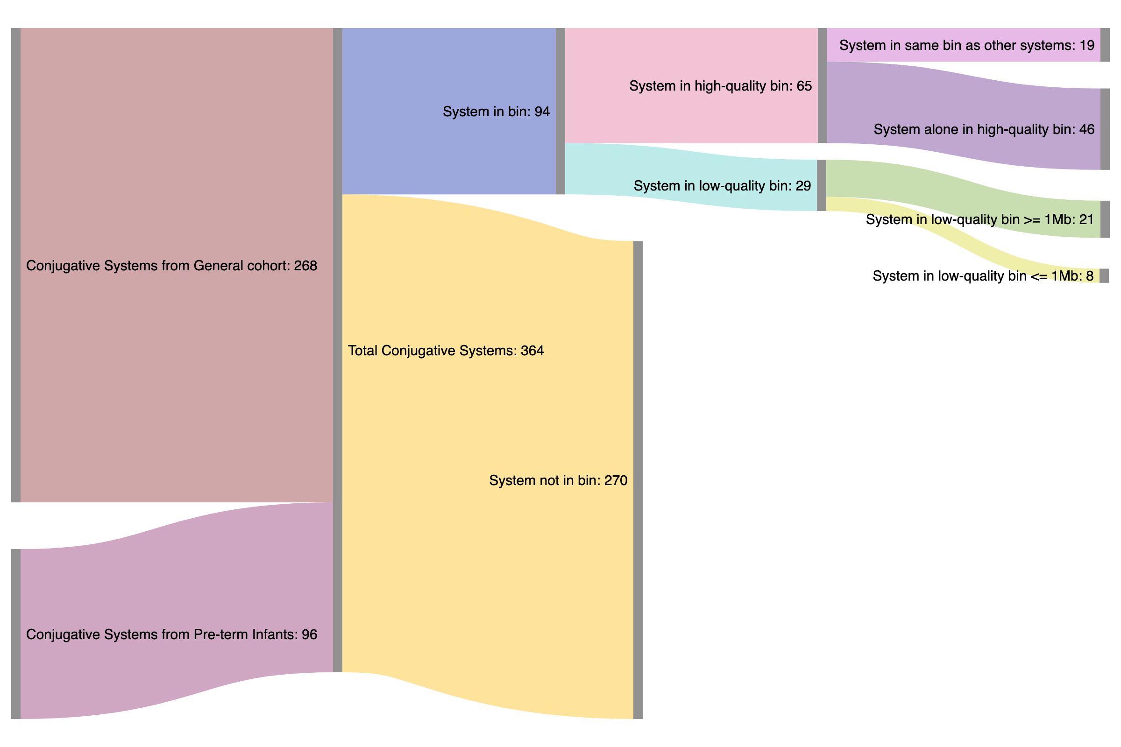
Assembled conjugative systems are largely omitted from binned genomes
Notes:
I also wanted to investigate whether these conjugative systems would be included in genomes by binning algorithms such as metabat2. What we can see in this flow diagram is that of the total 364 systems I identified in the assemblies, only 94 were included in bins, and only 65 were in high quality bins. Most conjugative systems would not be included in genomes. If you remember what causes these algorithms to group contigs together it’s abundance and tetranucleotide frequency. Plasmids can exist in cells in a greater copy number than one, so their abundance wont be the same as the genome, and they tend to be more AT rich than the genome. Both of these factors would cause the conjugative systems to be omitted from genome bins, and would therefore be omitted in many metagenomic assembly analyses.

Slide 28
Population-based comparison of conjugative systems from genome set
Identify conjugative contigs
genome_*.fa
Notes:
To quantify larger scale differences between cohorts, I took advantage of a large genome set of 2500 bacterial genomes found in the human gut rather than assembling data from roughly 800 samples, which would have taken months to years on our server. For this approach, I annotated the genomes using UniRef90, and searched for contigs again with annotations for the conjugative system proteins. Because the data were much smaller than the assemblies, this process was feasible, but it still took over a month of server time.

Slide 29
Population-based comparison of conjugative systems from genome set
Notes:
This is a principle components plot of the abundances of the identified conjugative systems across six cohorts. North American general (that I used in the assembly), north American indigenous, western European general, east Asian, south American, and a west African cohort. The north American and European cohorts clustered in the orange ellipsis, the east Asian in the purple, and the south American and west African in the blue ellipsis.

Slide 30
Population-based comparison of conjugative systems from genome set
Notes:
I did not include two of the cohorts in the principal components analysis because the two infant cohorts had virtually no signal for any of the identified conjugative systems. Of note, we have taken two of the Proteobacteria plasmids from this analysis and are attempting to synthesize them using a DNA printer to see if the systems I am identifying are truly conjugative.

Slide 31
Take home messages: conjugation
Assembled conjugative systems are extremely different in pre-term infants and a general cohort
Assembled conjugative systems are omitted from bins
Conjugation separates cohorts by age and geography
Notes:
What I can say from my result is that conjugative systems are very different in pre-term infants than in a general population. Also, conjugative systems are mostly omitted from bins. And finally, conjugative systems can separate cohorts based on age and geography.

Slide 32
Recent advancements in metagenomic assembly
Notes:
For the final part of my talk, I will discuss a recent advancement in metagenomic assembly which is the advent of long-read sequencing.

Slide 33
Long-read vs. short-read sequencing
Enabled by recent advancements in technology by Oxford Nanopore and PacBio
Illumina sequencing read length limited by platform
Long-read sequencing limited by DNA extraction length
Notes:
Long read sequencing technologies have been recently developed by two companies: Oxford Nanopore and Pacific Biosciences. Wheras Illumina sequencing has a fixed read length that is determined by the library and platform, in long-read sequencing the read length limit is determined by the length of DNA strands extracted for your sample. In theory, if you are careful enough, you can sequence DNA fragments over 1 million bases long which is in stark contrast to roughly 150 bases that you get from Illumina sequencing.

Slide 34
Implications for metagenomic assembly
Short-read assemblies break at repeated sequences due to ambiguity in the de Bruijn graph
Short-read assembly
Repeated regions
Notes:
As I previously mentioned, repeat sequences in a genome are the death of an assembly with short reads. The short reads are unable to span the repeated regions, which makes the difficult to assemble, and difficult to arrange. The three fragments of this assembly are impossible to join with short reads, and additionally, we can’t easily determine how the fragments are organized.

Slide 35
Implications for metagenomic assembly
Long reads can span the repeated sequence to eliminate ambiguities
Long-read assembly
Repeated regions
Notes:
However, if we use nanopore sequencing and are very careful with how we extract the DNA, we can generate reads that can span the repeat region and unambiguously resolve the assembly.

Slide 36
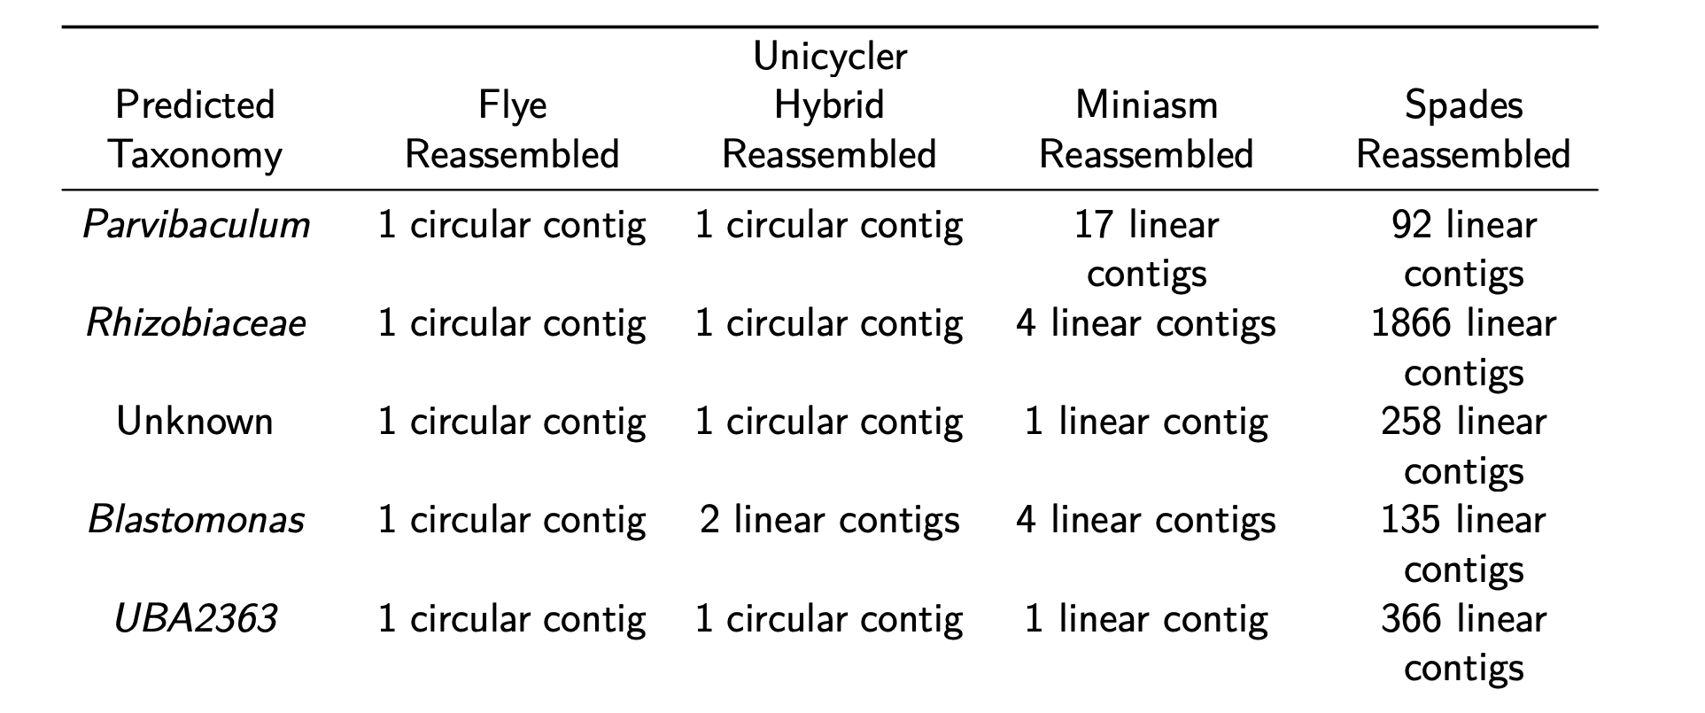
Implications for metagenomic assembly
Giguere et al. (2020) bioRxiv: doi: https://doi.org/10.1101/2020.04.08.032540
Notes:
We have shown this to work, even in a complex metagenomic community, and published our data as a preprint. We generated 10 circularized bacterial genomes, with an additional 3 genomes assembled as a single linear contig. The benefits of long-read assembly are clearly shown by comparing to the assembly with only short read data, where instead of 1 contig to represent the genome, the genomes are instead fragments into upwards to 1900 contigs.

Slide 37
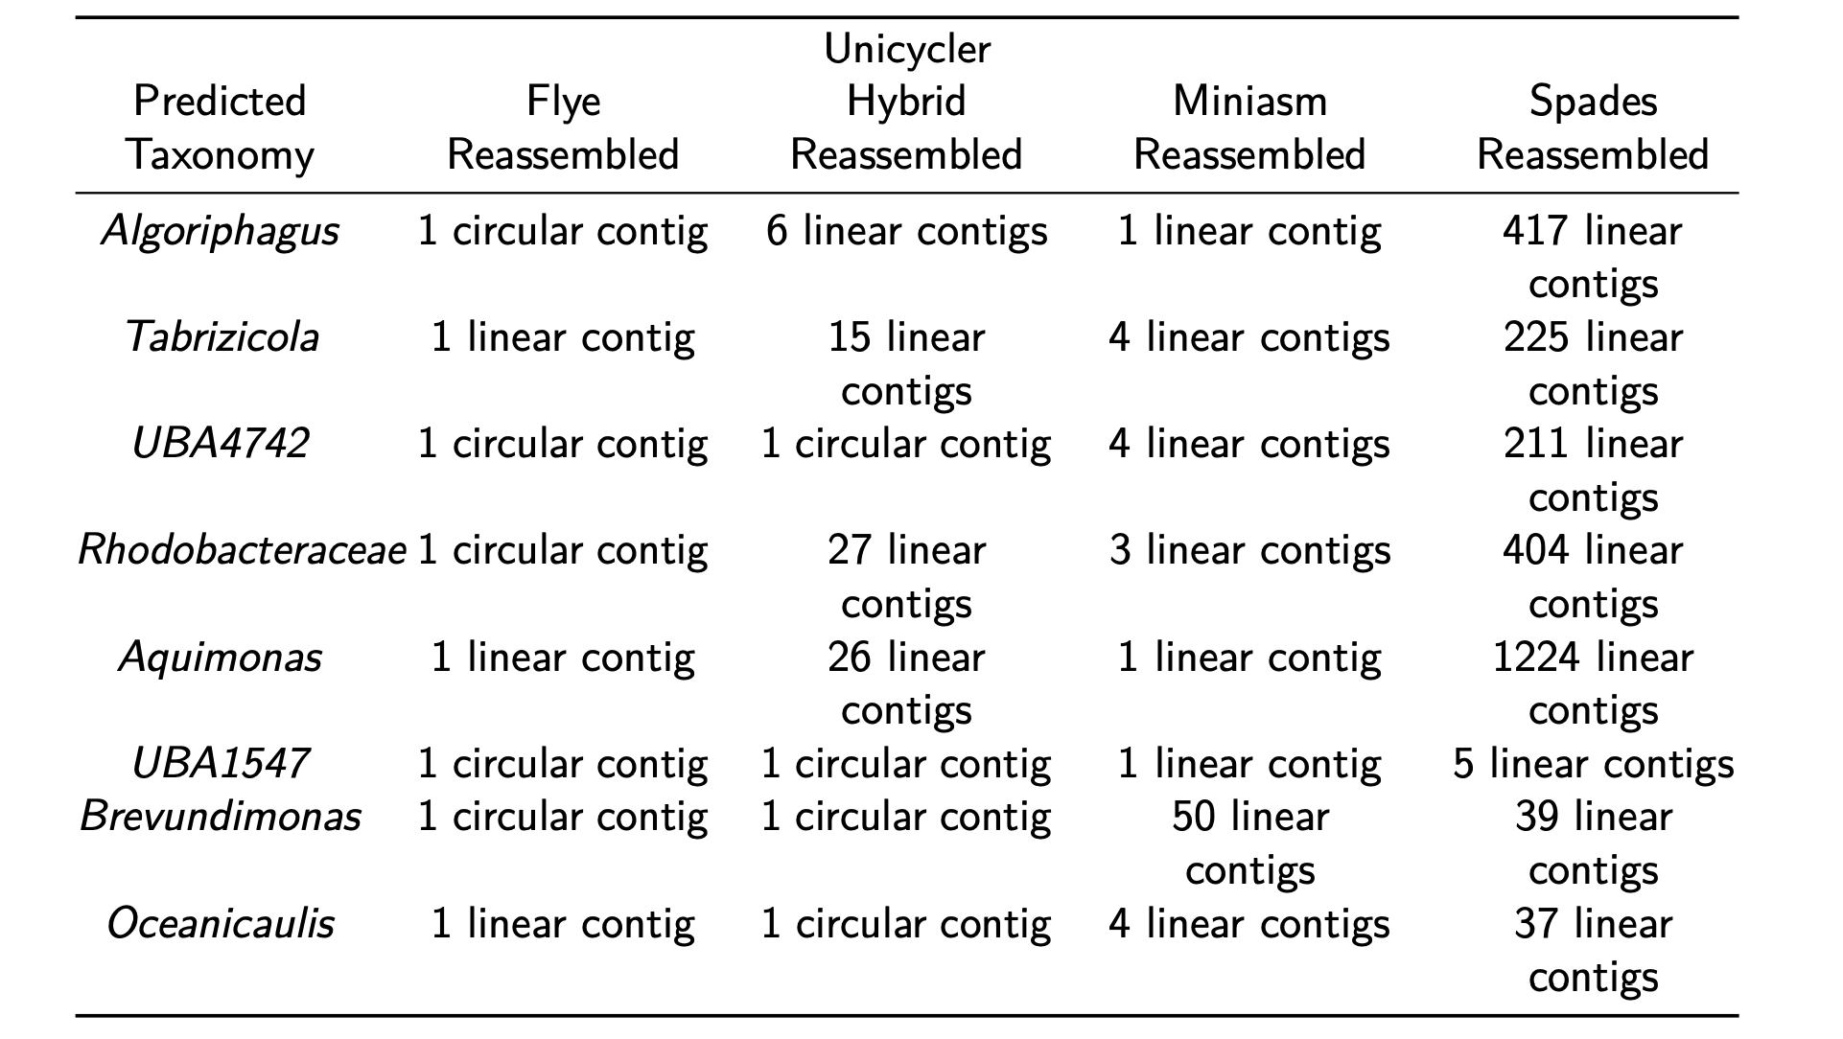
Implications for metagenomic assembly
Giguere et al. (2020) bioRxiv: doi: https://doi.org/10.1101/2020.04.08.032540
Notes:
These are the assembly results for the rest of the genomes we found in the community. I have to also note, that we did not phase out Illumina sequencing for an important reason. While the long-reads could assemble the genome into a single contig, Nanopore sequencing is still quite error-prone, so we used Illumina reads to correct the errors found in the assembled sequence.

Slide 38
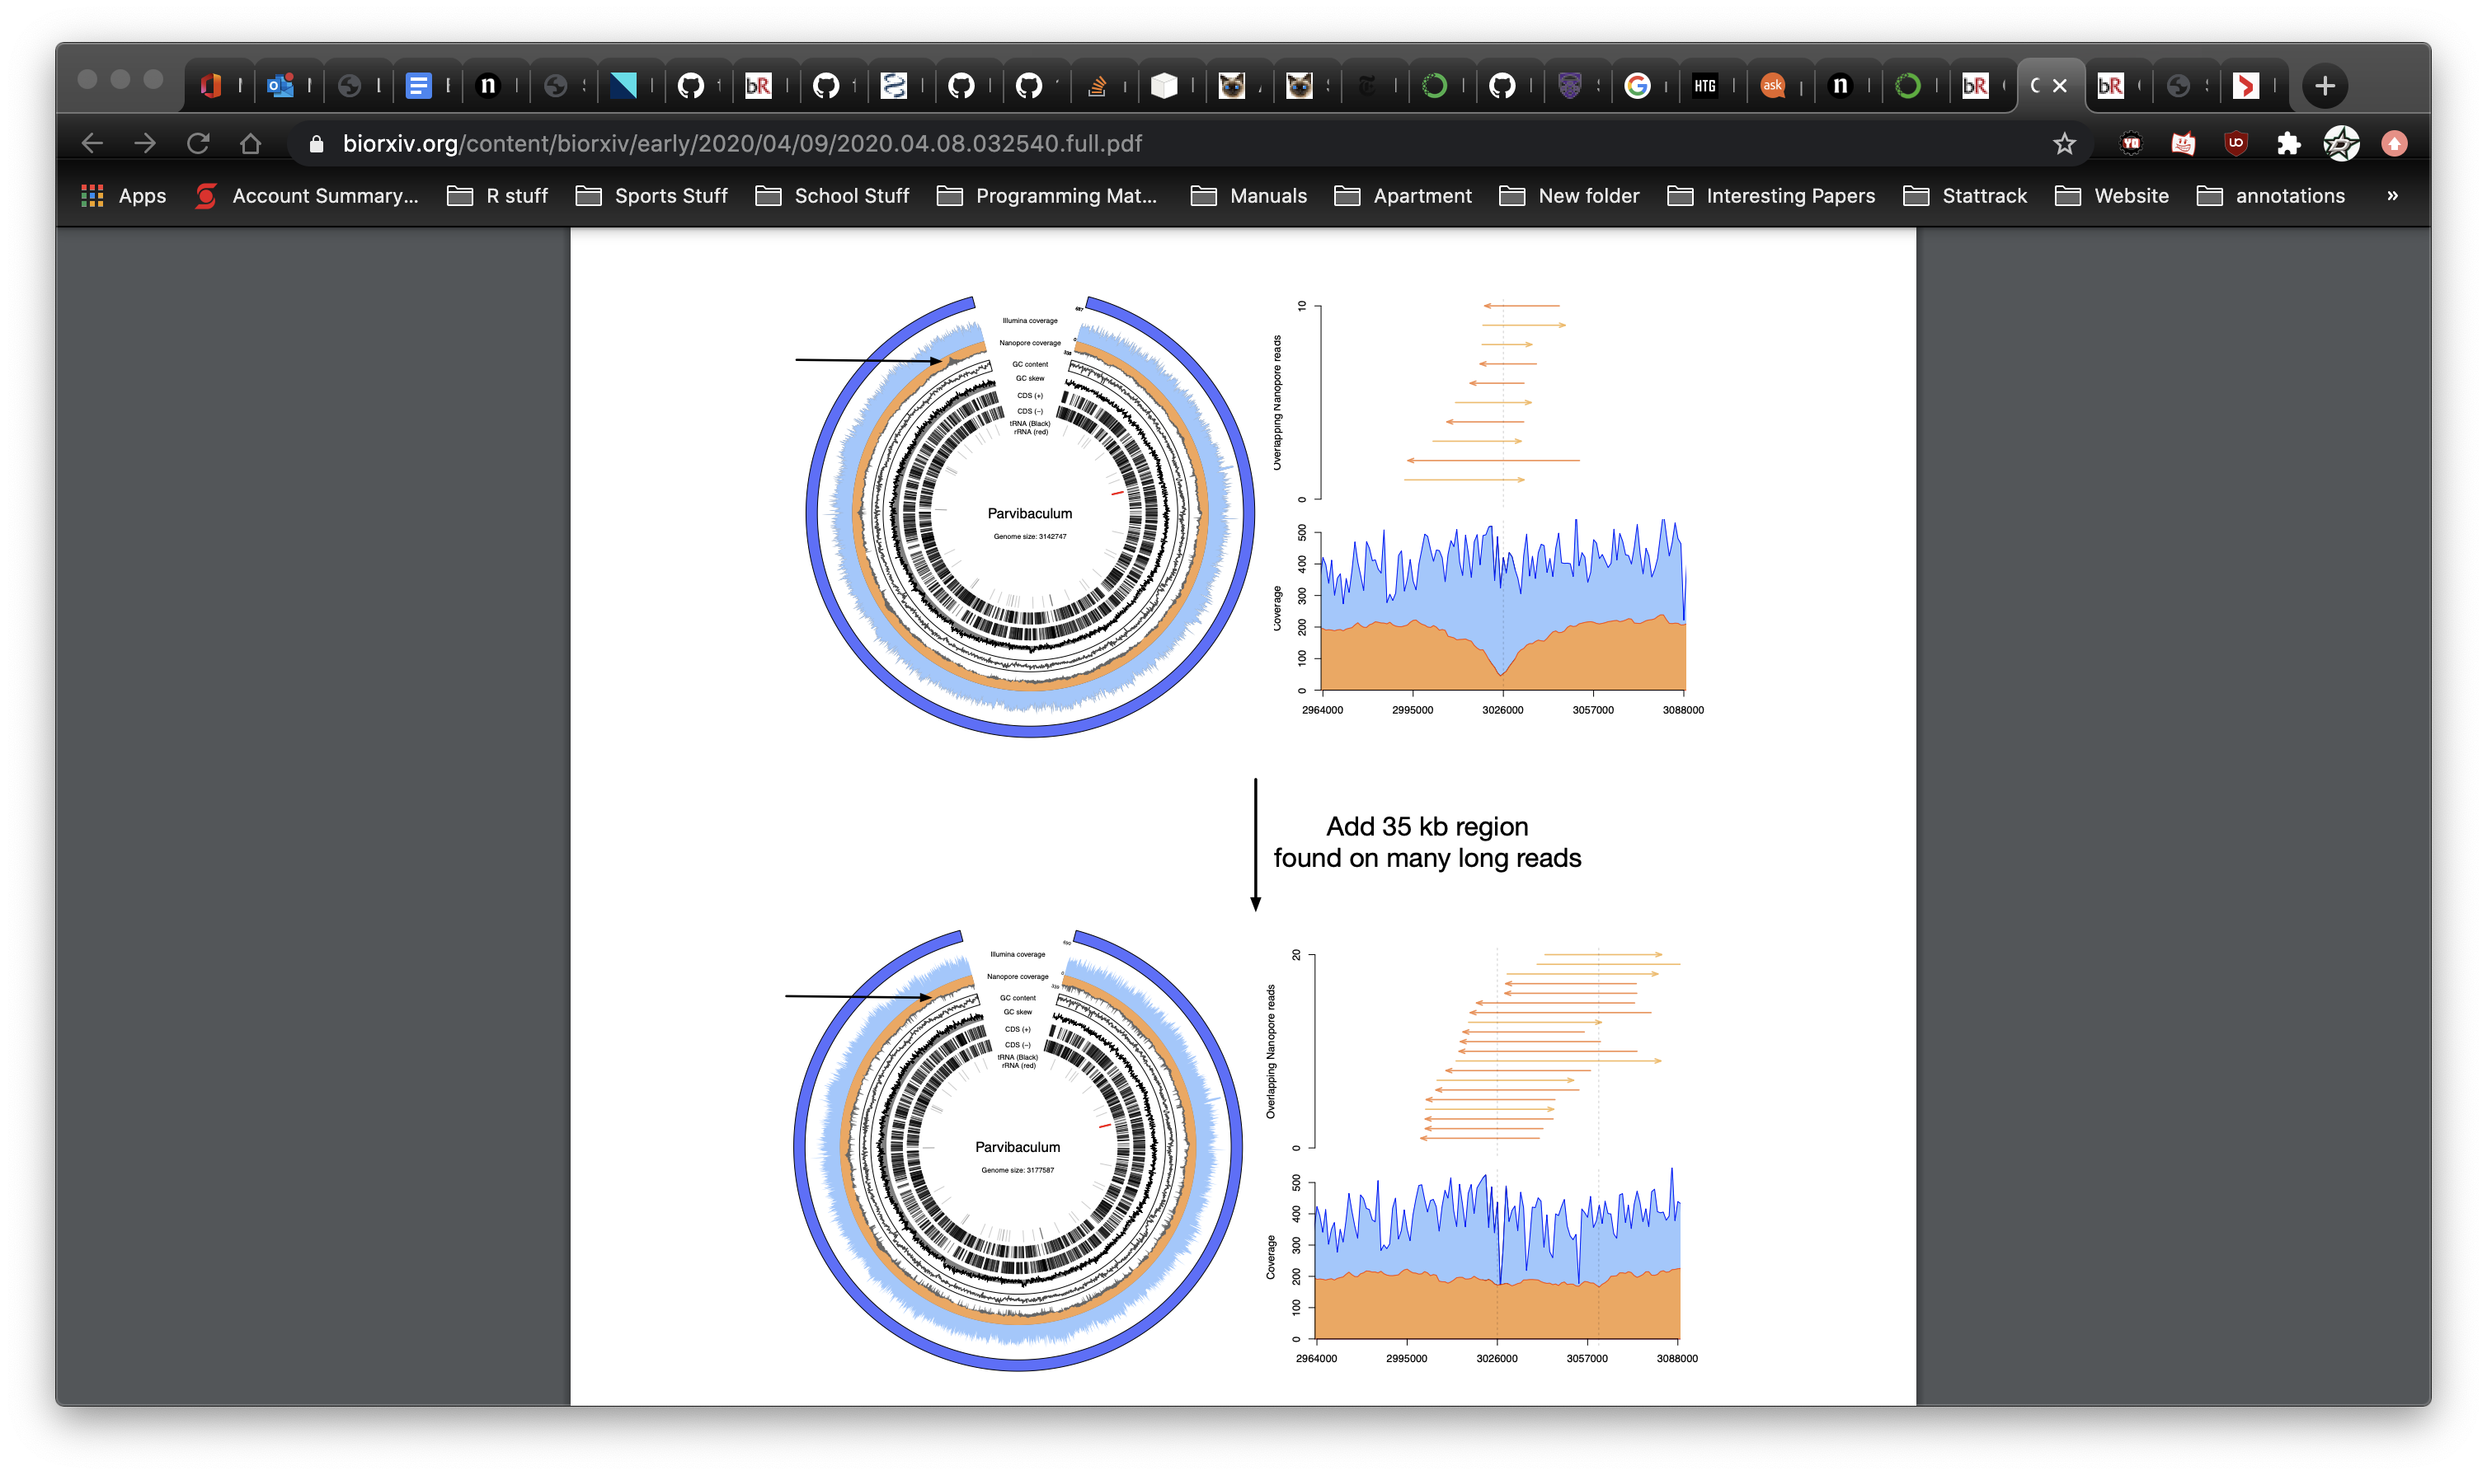
Implications for metagenomic assembly
Giguere et al. (2020) bioRxiv: doi: https://doi.org/10.1101/2020.04.08.032540
Notes:
From our assembly analysis, we were able to detect strain differences within a single sample. At this region in the Parvibaculum genome, we noticed a dip in the nanopore coverage. We resolved the assembly manually and found there is a different version of the assembly where there is a transposon inserted into the genome. Both versions of the genome have long reads that span this region, so we are confident that both strains exist in the sequenced environment.

Slide 39
Other recent (unpublished) work with long-reads
Along with the 13 complete genomes, we also assembled a number of plasmids
Not included in assembly
AMR genes
Short-read assembly
Long-read assembly
Notes:
Along with the genomes we assembled from the environmental sample, we also assembled a lot of small circularized sequences that appear to be plasmids, both conjugative and non-conjugative. Looking back at my work at examining conjugative systems, we would be confident that we wouldn’t be missing any important functional genes that may have been lost in a short-read assembly.

Slide 40
Other recent (unpublished) work with long-reads
Dan has recently assembled the genome of a microalgae telomere-to-telomere
Image: https://upload.wikimedia.org/wikipedia/commons/b/bf/Phaeodactylum_tricornutum.png
Notes:
My labmate Dan, who leads the nanopore research in our lab, has also recently completed a telomere-to-telomere assembly using nanopore sequencing. I don’t know how many of you follow the genomics community closely, but the human genome has only recently been assembled telomere-to-telomere by a massive team at the NIH, which was the culmination of many years of work. Dan and our former master’s student Alec have assembled this algae’s genome in only a couple of months.

Slide 41
Future directions and needs
DNA extraction for Nanopore sequencing is laborious (phenol/chloroform extraction, spooling)
Untapped market for effective DNA extraction kits
Over the next few years, long-read sequencing will be the norm, and very little competition in the market (Cirulomics, Oxford Nanopore)
Notes:
The current issue with Nanopore sequencing is how difficult the DNA extraction is. Dan has to perform phenol/chloroform extractions and spool the DNA for every sample. This is because the integrity of the DNA must be maintain throughout the process. Regular DNA extraction kits use bead beating and other methods and reagents that shear the DNA. The resultant DNA ends up extremely fragmented and you might as well use illumine sequencing at that point. This problem represents an relatively untapped market for effective DNA extraction kits. Dan and I are of the opinion that Nanopore sequencing is the going to be the norm in the very near future as the base calling accuracy continues to approach Illumina quality. And currently, the only companies producing reagents for Nanopore sequencing are Circulomics and Oxford Nanopore.

Slide 42
Future directions and needs
Needs in a kit:
Read length
Able to lyse all bacteria
Usable for human stool samples
Notes:
What we need in a kit is primarily a kit optimized to extracting high molecular weight DNA. We look to achieve an read length N50 of over 25 kilobases for a metagenomic assembly. Additionally, because the kit needs to avoid physical lysis methods to preserve the integrity of the DNA, the kit must ensure that it can lyse all bacteria. This is important for bacterial communities like human stool samples that have many bacteria that can be hard to lyse. In the near future, I’m going to be doing the sequencing analyses for an human FMT trial, and we will be performing nanopore sequencing on the donors. An effective DNA extraction kit for human stool would make my wet lab collaborator’s lives a lot easier.

Slide 43
Closing Remarks

Slide 44
In summary…
Metagenomic assembly offers far more insight into the composition of a community than 16S sequencing or read-based analyses
Nanopore and PacBio long-read sequencing are rapidly advancing and creating a market need for effective reagents
Notes:
In summary, metagenomic assembly provides far more insight into a bacterial community that 16S gene sequencing or metagenomic read analyses. And nanopore long read sequencing technology is fast-advancing and creating a market for reagent. Frankly reflecting on my work so far as a scientist, I am left with the feeling that much of my work that is solely base on Illumina sequencing is becoming obsolete. Where metagenomic assemblies felt like rough approximations with short reads, with long-read assemblies I feel like we can truly capture the bacterial genomes present in an environment.

Slide 45
Thank you!

